Slide 1


Testing in an Agile Environment

Slide 2

Matthew (Matt) Harsh, MBA, CSM
Manager / Sr. Automation Architect
Background
Automation Frameworks & Architecture
Automation Leadership
Implementation of frameworks using Selenium (WebDriver & Grid), CodedUI, Appium, UFT, SOASTA, Cucumber-JVM, SpecFlow, SilkTest, Silk4J, Protractor, SoapUI, Sikuli & Tosca
Used JUnit, TestNG, MSTest, MbUnit, xUnit & Nunit unit testing frameworks in conjunction with above mentioned tools
Implemented Continuous Integration and Continuous Delivery Pipelines using Jenkins, TFS & VSTS
Certified Scrum Master (Scrum Alliance) since 2010

Slide 3
Agenda
A Disciplined Agile Approach
Test Disciplines in Agile
Manual (Interactive)
Test Automation
Inverted Test Automation Pyramid (Snow Cone)
Test Automation Pyramid (Detailed)
Agile Testing Quadrants
Agile Testing Quadrant 1 Explained
Agile Testing Quadrant 2 Explained
Agile Testing Quadrant 3 Explained
Agile Testing Quadrant 4 Explained
Sprint and Sprint + 1 Automation
Sprint + 1 Landscape
Hardening Sprint
Continuous Integration & Delivery (DevOps)
Continuous Delivery Testing Environment
CI/CD tools

Slide 4


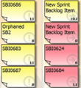
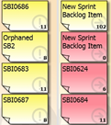
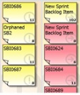


A Disciplined Agile Approach
Daily Scrum
Sprint (Iterative)
Vision
Sprint Review
Retrospective
Release Planning
Deployable Increment
Deploy
Release
Sprint Planning
Product Backlog
(JIRA)
Product

Slide 5
Manual Testing in Agile (Ideally)
Should be minimized
Works with Product Owner closely
Works closely with the entire agile team
Acts as a subject matter expert (SME)
Logging defects
Focus on exploratory testing (or should be)
Assist Test Automation Engineers (e.g. data setup)

Slide 6
Automation Testing in Agile (Ideally)
Should be maximized
Works with Development closely
Works closely with the entire agile team
Acts as a subject matter expert (SME)
Logging defects
Focus build verification tests, smoke, in-sprint regression and release regression testing
Reporting automation execution results

Slide 7
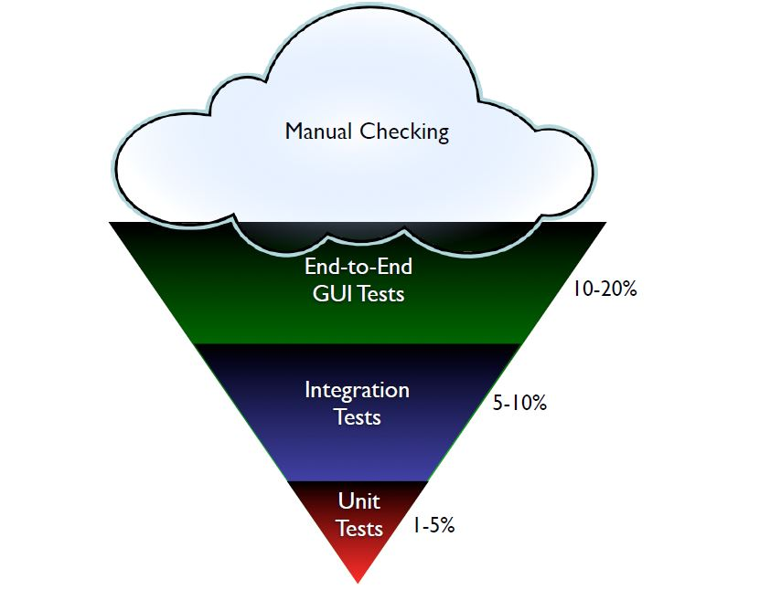

Inverted Test Automation Pyramid (The Snow Cone)

Slide 8
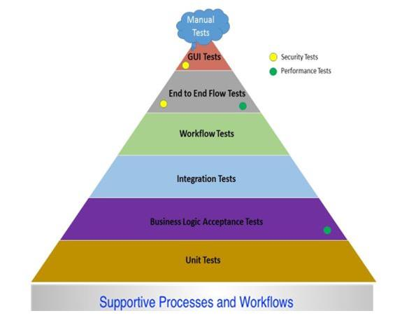
Test Automation Pyramid (Detailed)

Slide 9
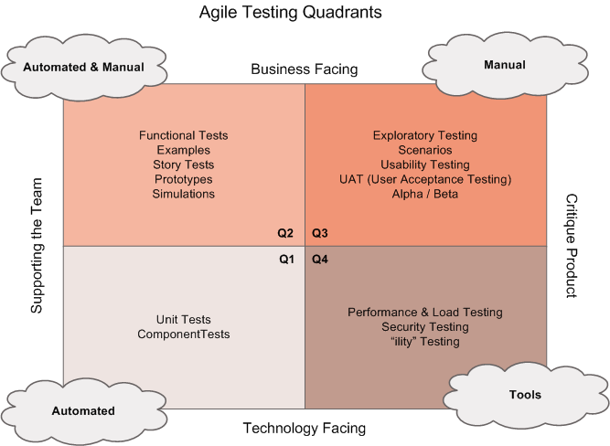
Agile Testing Quadrants

Slide 10
Agile Testing Quadrant 1 Explained
This Quadrant focuses mainly on internal code quality. The unit testing done in this Quadrant acts as an initial safety net for the product and helps developer get the story right. The tests performed in Quadrant 1 provide instant feedback about the project/product.
If Test Driven Development (TDD) is adapted design becomes better and stronger. The testability is built into the code in this Quadrant.
All these tests are automated.
The kinds of tests in this Quadrant are:
Unit Tests - Tests a piece of code (e.g. method or class) and ensuring that it fulfills the specifications.
Component Tests - Tests architecture modules ensuring that components work together.

Slide 11
Agile Testing Quadrant 2 Explained
This Quadrant focuses on eliciting the requirements. Developer’s code should pass test cases being executed. Defects are typically start to be written in this Quadrant. The test cases are business facing and so development is driven keeping the business requirements (stories) in mind. The objective of this Quadrant is to obtain enough requirements so that coding can continue on new features without any issues. As much as these tests should be automated.
The kind of tests in this Quadrant are:
Scenario/Workflow Tests (Most QA Test Cases): Examples of possible scenarios and workflows.
Prototype Tests: Testing of User Experience, sometimes included in QA Test Cases.
Pair Testing: Testers and developers or business analysts or between two testers with both participants taking turns at driving the keyboard.

Slide 12
Agile Testing Quadrant 3 Explained
This Quadrant enables he product to be evaluated since realistic use of the product is kept in mind in this Quadrant. The many number of iteration reviews in this Quadrant creates confidence in the project/product and insures a quick feedback loop. The demos can be given on unfinished code to gain insight into the working of the projects/product, if mocks are used. Exploratory testing can be paired with the customer/stakeholder. There are some tools for automating for portions of this Quadrant but it is mostly manual.
The kind of tests in this Quadrant are:
Exploratory Tests: Hands-on approach in which testers are involved in minimum planning and maximum test execution.
Usability Tests: UX centric tests, which testing real world use of the project/product.
Pair Tests w/ Customers: Same as Pair Tests done in Quadrant 2 but with a customer.
User Acceptance Tests (UAT): Tests performed by stakeholders and/or customers.

Slide 13
Agile Testing Quadrant 4 Explained
This Quadrant focuses on the non-functional requirements (NFR Testing) including performance, scalability, security, stability, etc. This Quadrant is responsible to deliver the finished project/product. The application is made to deliver the expected value and non-functional requirements with help of this Quadrant.
Kind of tests in this Quadrant:
Security Tests: Tests for authentication, authorization, hacking etc.
Infrastructure Tests: Tests to validate infrastructure components, reducing the chance of downtime and improving the performance of overall infrastructure.
Data Migration Testing: Tests transferring data between computer storage types or file formats (e.g. DB upgrade).
Scalability Tests: Tests are an extension of performance testing. The purpose is to identify major workloads and mitigate bottlenecks that can impede the scalability of the application.
Load Tests: Tests that put demand (stress) on a software system and measuring its response.

Slide 14
In-Sprint & Sprint + 1 Test Automation
In-Sprint Test Automation:
Test automation is part of the Definition of Done (Done Criteria).
This includes UI test automation and Web service test automation.
Only achievable if the entire team works together.
Typically requires Test Driven Development (TDD) Behavior Driven Development (BDD) test automation frameworks.
Test automation scripts change frequently in sprint due to feature creation unless TDD/BDD is used.
Mocking is essential.
Included as tasks in stories
Sprint + 1 Test Automation:
Test automation is not part of the Definition of Done (Done Criteria).
This includes UI test automation and Web service test automation.
Still requires the entire team working together.
Less maintenance than In-Sprint test automation due to less frequent feature changes.
Should be its own story with tasks for effort tracking

Slide 15
Hardening Sprint
A Hardening Sprint is an additional sprint that some Scrum teams run at the completion of all the regular sprints. They are planned for developing functionality based on the product backlog. While the hardening sprint usually focuses on final integration before the release, teams often use it to tie up the loose ends identified during earlier sprints, such as data issues or defects related to external interfaces.
Most teams face the need for a hardening sprint when they near the release. They find that integration issues were not addressed in the earlier sprints, or the relevant data could not be used for testing. These issues force teams to introduce an additional sprint, and often the teams negotiate with the stakeholders for the additional time and effort.
Adopting DevOps practices such as continuous deployment makes the hardening sprint redundant. With automated builds and early involvement of the operations team, a near-production environment could be made available for testing and teams could uncover potential production issues up front to improve system behavior and overall application quality. With successful adoption of such practices, teams will be able to get the application ready for deployment whenever business wants.

Slide 16
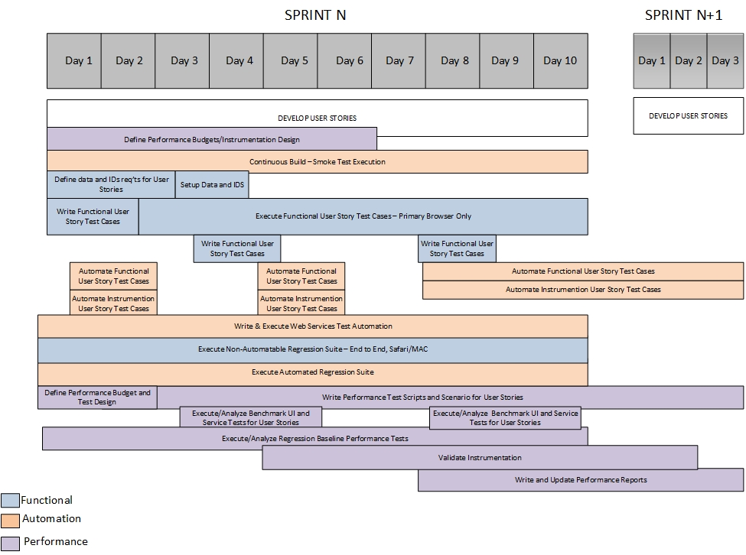
Sprint + 1 Testing Landscape

Slide 17
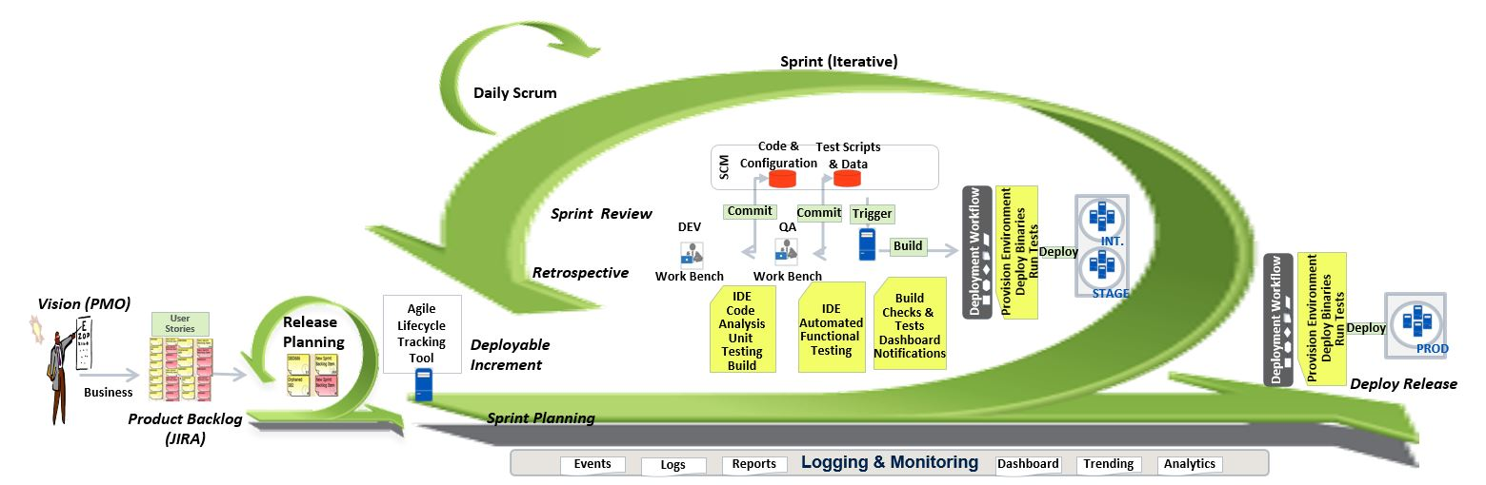
Continuous Integration & Delivery (DevOps) Approach

Slide 18
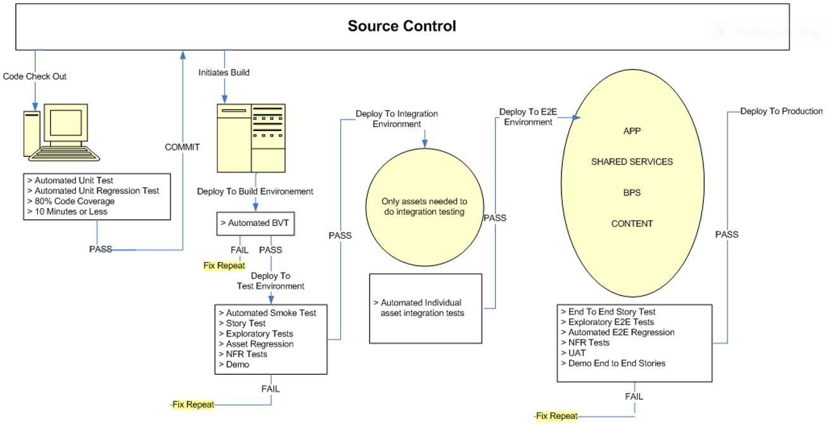
Continuous Delivery Testing Environment

Slide 19
Continuous Integration Tools for Continuous Delivery
Continuous Integration:
Jenkins - An open source continuous integration tool with automated continuous build and monitoring of externally-run jobs (e.g. cron jobs)
Hudson - An open source continuous integration tool with automated continuous build and monitoring of externally-run jobs (e.g. cron jobs).
Team City - Proprietary continuous integration system that integrates with Git and Mercurial.
Cruise Control - It is both a continuous integration tool and an extensible framework for creating a custom continuous build process.
Bamboo - A proprietary tool that runs builds and tests.
Go - An open source continuous integration tool.
Travis - A proprietary continuous integration system.
Version Control:
Subversion - An open source version control system (VCS) that is used for version control of code.
Team Foundation Server - Microsoft’s VCS. Includes continuous integration, issue tracking, and other features.

Slide 20
Continuous Integration Tools for Continuous Delivery (cont.)
Version Control (cont.)
Git - An open source version control system that’s distributed, so you can check in code and merge it while you are working offline.
Mercurial - It is an open source distributed VCS where you can check in code and merge it while working offline.
Perforce - A proprietary version control system that supports Git.
Code Review:
Crucible - A proprietary collaborative code review tool.
Gerrit - A web-based code review tool that helps online code review using the Git version control system.
GitHub - An online repository for collaboration, code review and code management.
Stash - A proprietary tool for reviewing code in Git with enhanced features.
Confirmation Management:
Puppet - A configuration management platform that is available both as an open source project and as a proprietary tool for enterprise companies. It is used for automating server management and other tasks.

Slide 21
Continuous Integration Tools for Continuous Delivery (cont.)
Confirmation Management (cont.):
Puppet - A configuration management platform that is available both as an open source project and as a proprietary tool for enterprise companies. It is used for automating server management and other tasks.
Ansible - Ansible seamlessly unites workflow orchestration with configuration management, provisioning, and application deployment in one easy-to-use and deploy platform.
Vagrant - It is a CM tool for building complete development environments. With an easy-to-use workflow and focus on automation, Vagrant lowers development environment setup time and increase development/production parity.
Monitoring:
Logstash - An open source tool for managing logs and other event data from your systems.
Nagios - A monitoring and alerting tool for applications, servers, switches, and services.
Splunk - A tool for monitoring and visualizing data from your website, applications, servers, networks, and other devices.

Slide 22
Continuous Integration Tools for Continuous Delivery (cont.)
Orchestration:
Chef - It is a tool written in Ruby and it is used for automating orchestration steps (extension to Chef. Chef-metal allows you to use the core Chef principles to manage other aspects of your infrastructure. For example, when using Amazon Web Services (AWS), we can manage core AWS components such as Elastic Load Balancers (ELBs), Simple Queue Service (SQS) queues, compute resources, and other components using chef-metal).
Puppet - It facilitates automation of orchestration tasks. Puppet Enterprise makes it possible to drive change and easily orchestrate ordered deployments across your infrastructure and applications. You can run phased, canary deployments exactly when you want and fully control the roll out of changes, whether to an isolated set of your infrastructure, a specific application, or your entire data center.
Ansible - Ansible seamlessly unites workflow orchestration with provisioning and application deployment in one easy-to-use and deploy platform. The clear syntax and task based nature of the tool helps in automating the orchestration tasks effectively.

Slide 23
Continuous Integration Tools for Continuous Delivery (cont.)
Dashboards:
Jenkins - An open source continuous integration tool with automated continuous build and monitoring of externally-run jobs (e.g. cron jobs). The dashboard displays the status and progress of each job. Various plugins are available to create good dashboards using the tool.
Bamboo - A proprietary tool that runs builds and tests. The dashboard is the Bamboo home page which shows Bamboo's agents and build queue, showing which plans Bamboo is currently building and which plans are waiting to be built and other information.
Go - An open source continuous integration tool and which has dashboards that communicate the status of the environment.

Slide 24

THANK YOU

